Slide 1

Finite State Automata in Natural Language Processing
DSA0302 – Natural Language Processing
Presented by:
M. Niharika - 192472392
Guided By:
Dr. T. Devi

Slide 2


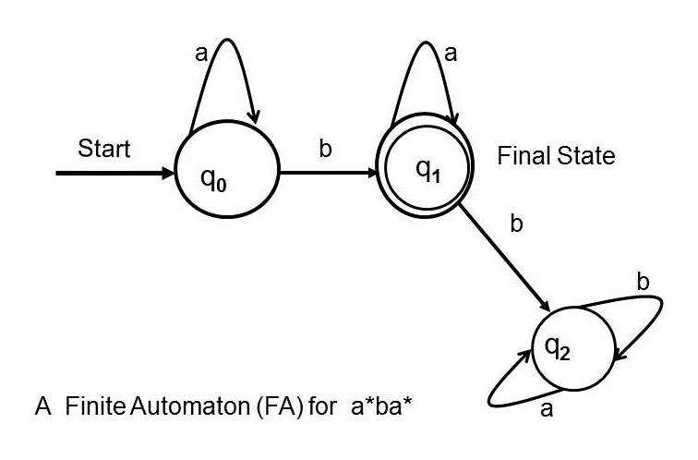
INTRODUCTION
Finite State Automata (FSA):
FSA is a computational model with a finite number of states.
It processes one input symbol at a time.
It accepts or rejects strings based on state transitions.
Components
Input Alphabet
Transition Function
Start State
Accept (Final) State
Explanation: FSA reads an input string character by character and moves between states according to predefined rules.

Slide 3
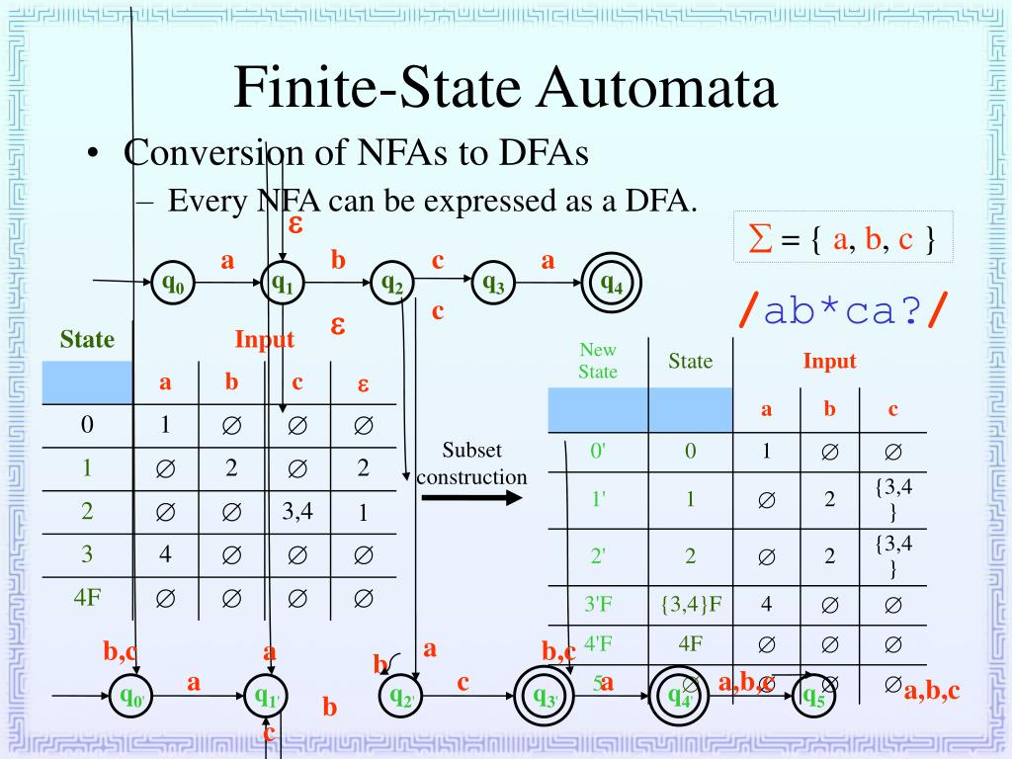
Types of Finite Automata
Deterministic Finite Automata (DFA)
One transition for each input symbol.
Faster and easier to implement.
No ambiguity in state transitions.
Non-Deterministic Finite Automata (NFA)
Multiple transitions are possible.
Supports ε (epsilon) transitions.
More flexible for designing automata.

Slide 4
Role in NLP
Lexical Analysis
Splits text into tokens (words, numbers, symbols).
Identifies valid keywords and identifiers.
Used in tokenization and text preprocessing.
Language Recognition
Checks whether a string follows language rules.
Recognizes valid words and patterns.
Used in spell checking and syntax validation.

Slide 5
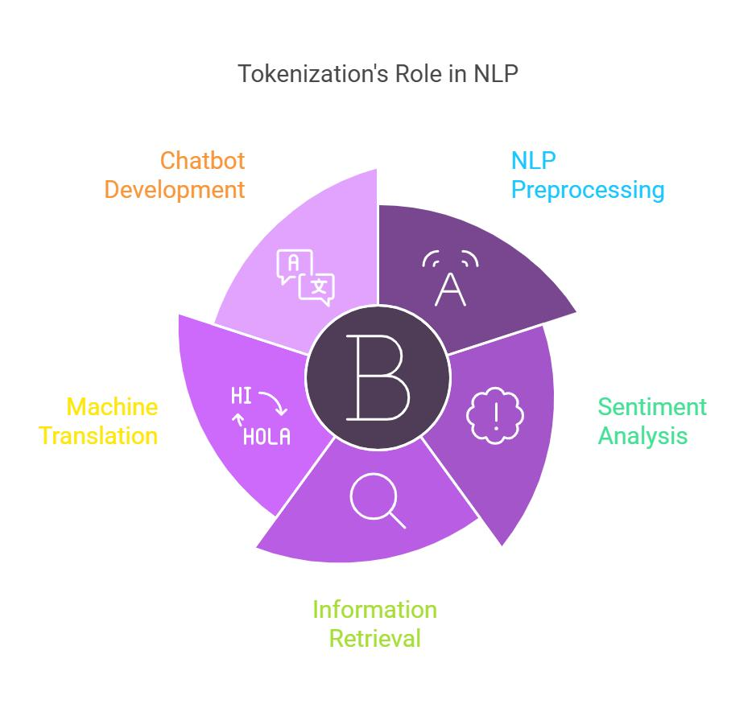
Applications
Applications:
Tokenization
Spell Checking
Pattern Matching
Search Engines
Chatbots
Speech Recognition
Text Processing
Benefits
Fast execution
Easy implementation

Slide 6
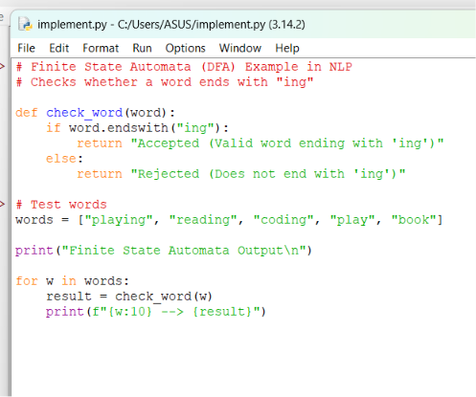
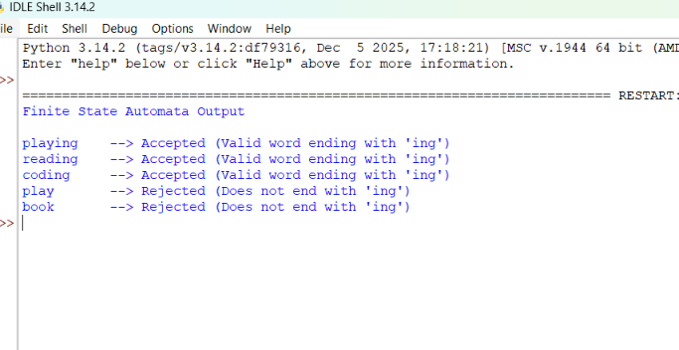
IMPLEMENTATION

Slide 7
CONCLUSION
Finite State Automata (FSA) are fundamental computational models used in Natural Language Processing (NLP).
Deterministic Finite Automata (DFA) provide fast, simple, and predictable pattern recognition.
Non-Deterministic Finite Automata (NFA) offer greater flexibility for designing language recognition systems.
FSA plays a vital role in lexical analysis, tokenization, and language recognition.
It serves as the foundation for many modern NLP applications, including spell checking, search engines, chatbots, and text processing.

Slide 8


